Slide 1
Hands-on AI in Action with Webex Contact Center
LTRCCT-2000
Dominic Franklin Gonsalves
Solution Manager - Webex
Session ID: LTRCCT-2000

Slide 2

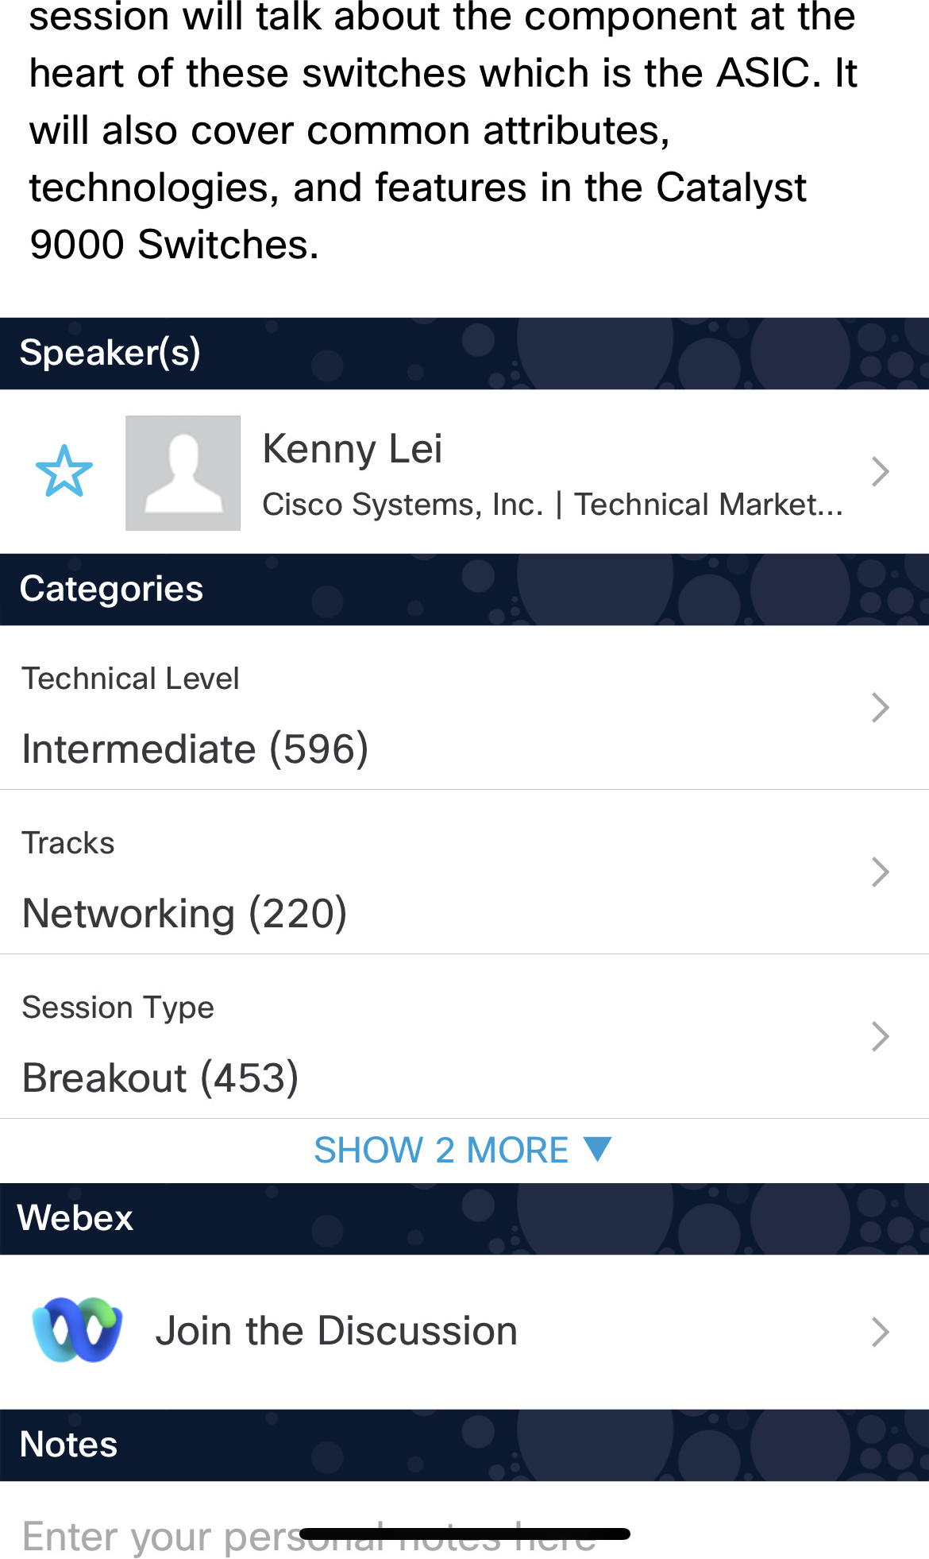

Cisco Webex App
Catalyst 9000 Series Switching Family - …
Questions?
Use Cisco Webex App to chat with the speaker after the session
How
1
Find this session in the Cisco Live Mobile App
Click “Join the Discussion”
Install the Webex App or go directly to the Webex space
Enter messages/questions in the Webex space
2
3
4
Webex spaces will be moderated by the speaker until 14 November 2025.
Enter your personal notes here
https://ciscolive.ciscoevents.com/ ciscolivebot/#BRKXXX-xxxx

Slide 3
Agenda
01
CX and Webex Contact Center Intro
02
Contact Flow and AI layout
03
Lab Overview
04
Autonomous AI Agent
05
Scripted AI Agent (Bonus)

Slide 4
Proliferation of new communication channels
Leveraging Artificial Intelligence
CX challenges to solve for
Improving Agent and contact center effectiveness
Reducing attrition, improving Agent Wellbeing
Automating and orchestrating systems

Slide 5






The AI Difference: Beyond Just Products
Moving contact center solutions to AI-powered experiences requires more than software implementation.
North Star Vision
Guiding principles that align technology with business outcomes.
Moving Business Needles
Measurable KPIs that demonstrate tangible value creation.
Success Indicators
Clear metrics to validate when AI implementation is working.
Beyond Products
Holistic approach combining technology, people, and processes.
This Lab helps you navigate this journey with purpose-built solutions that drive real business results.

Slide 6
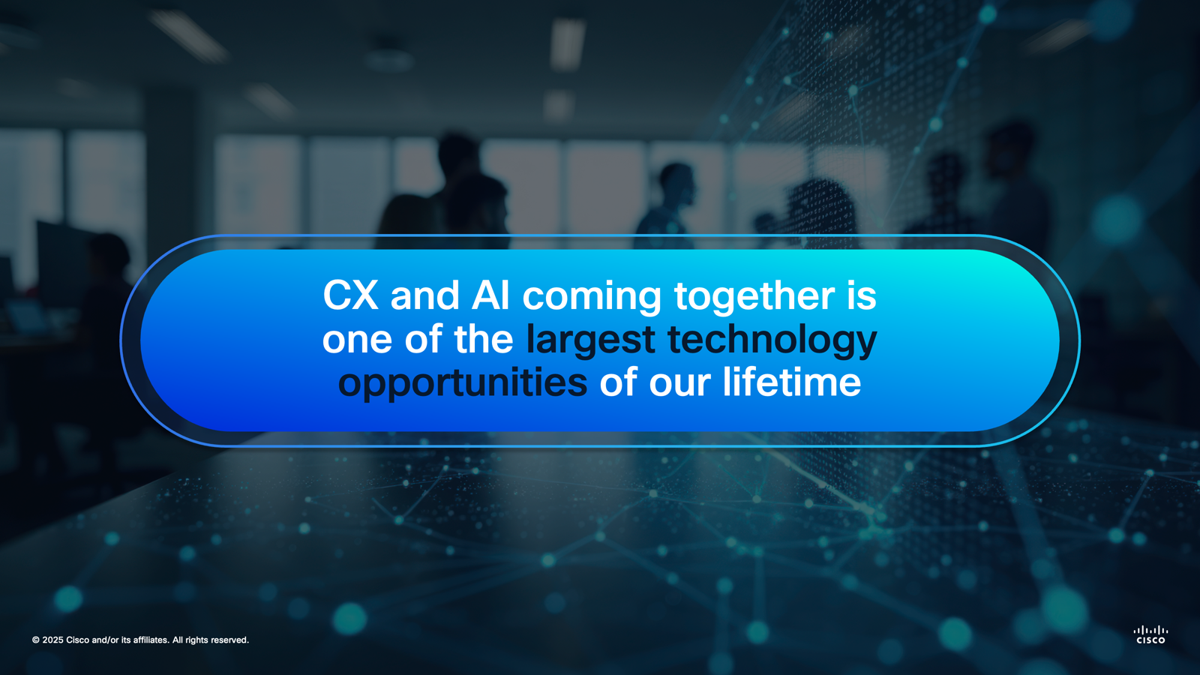
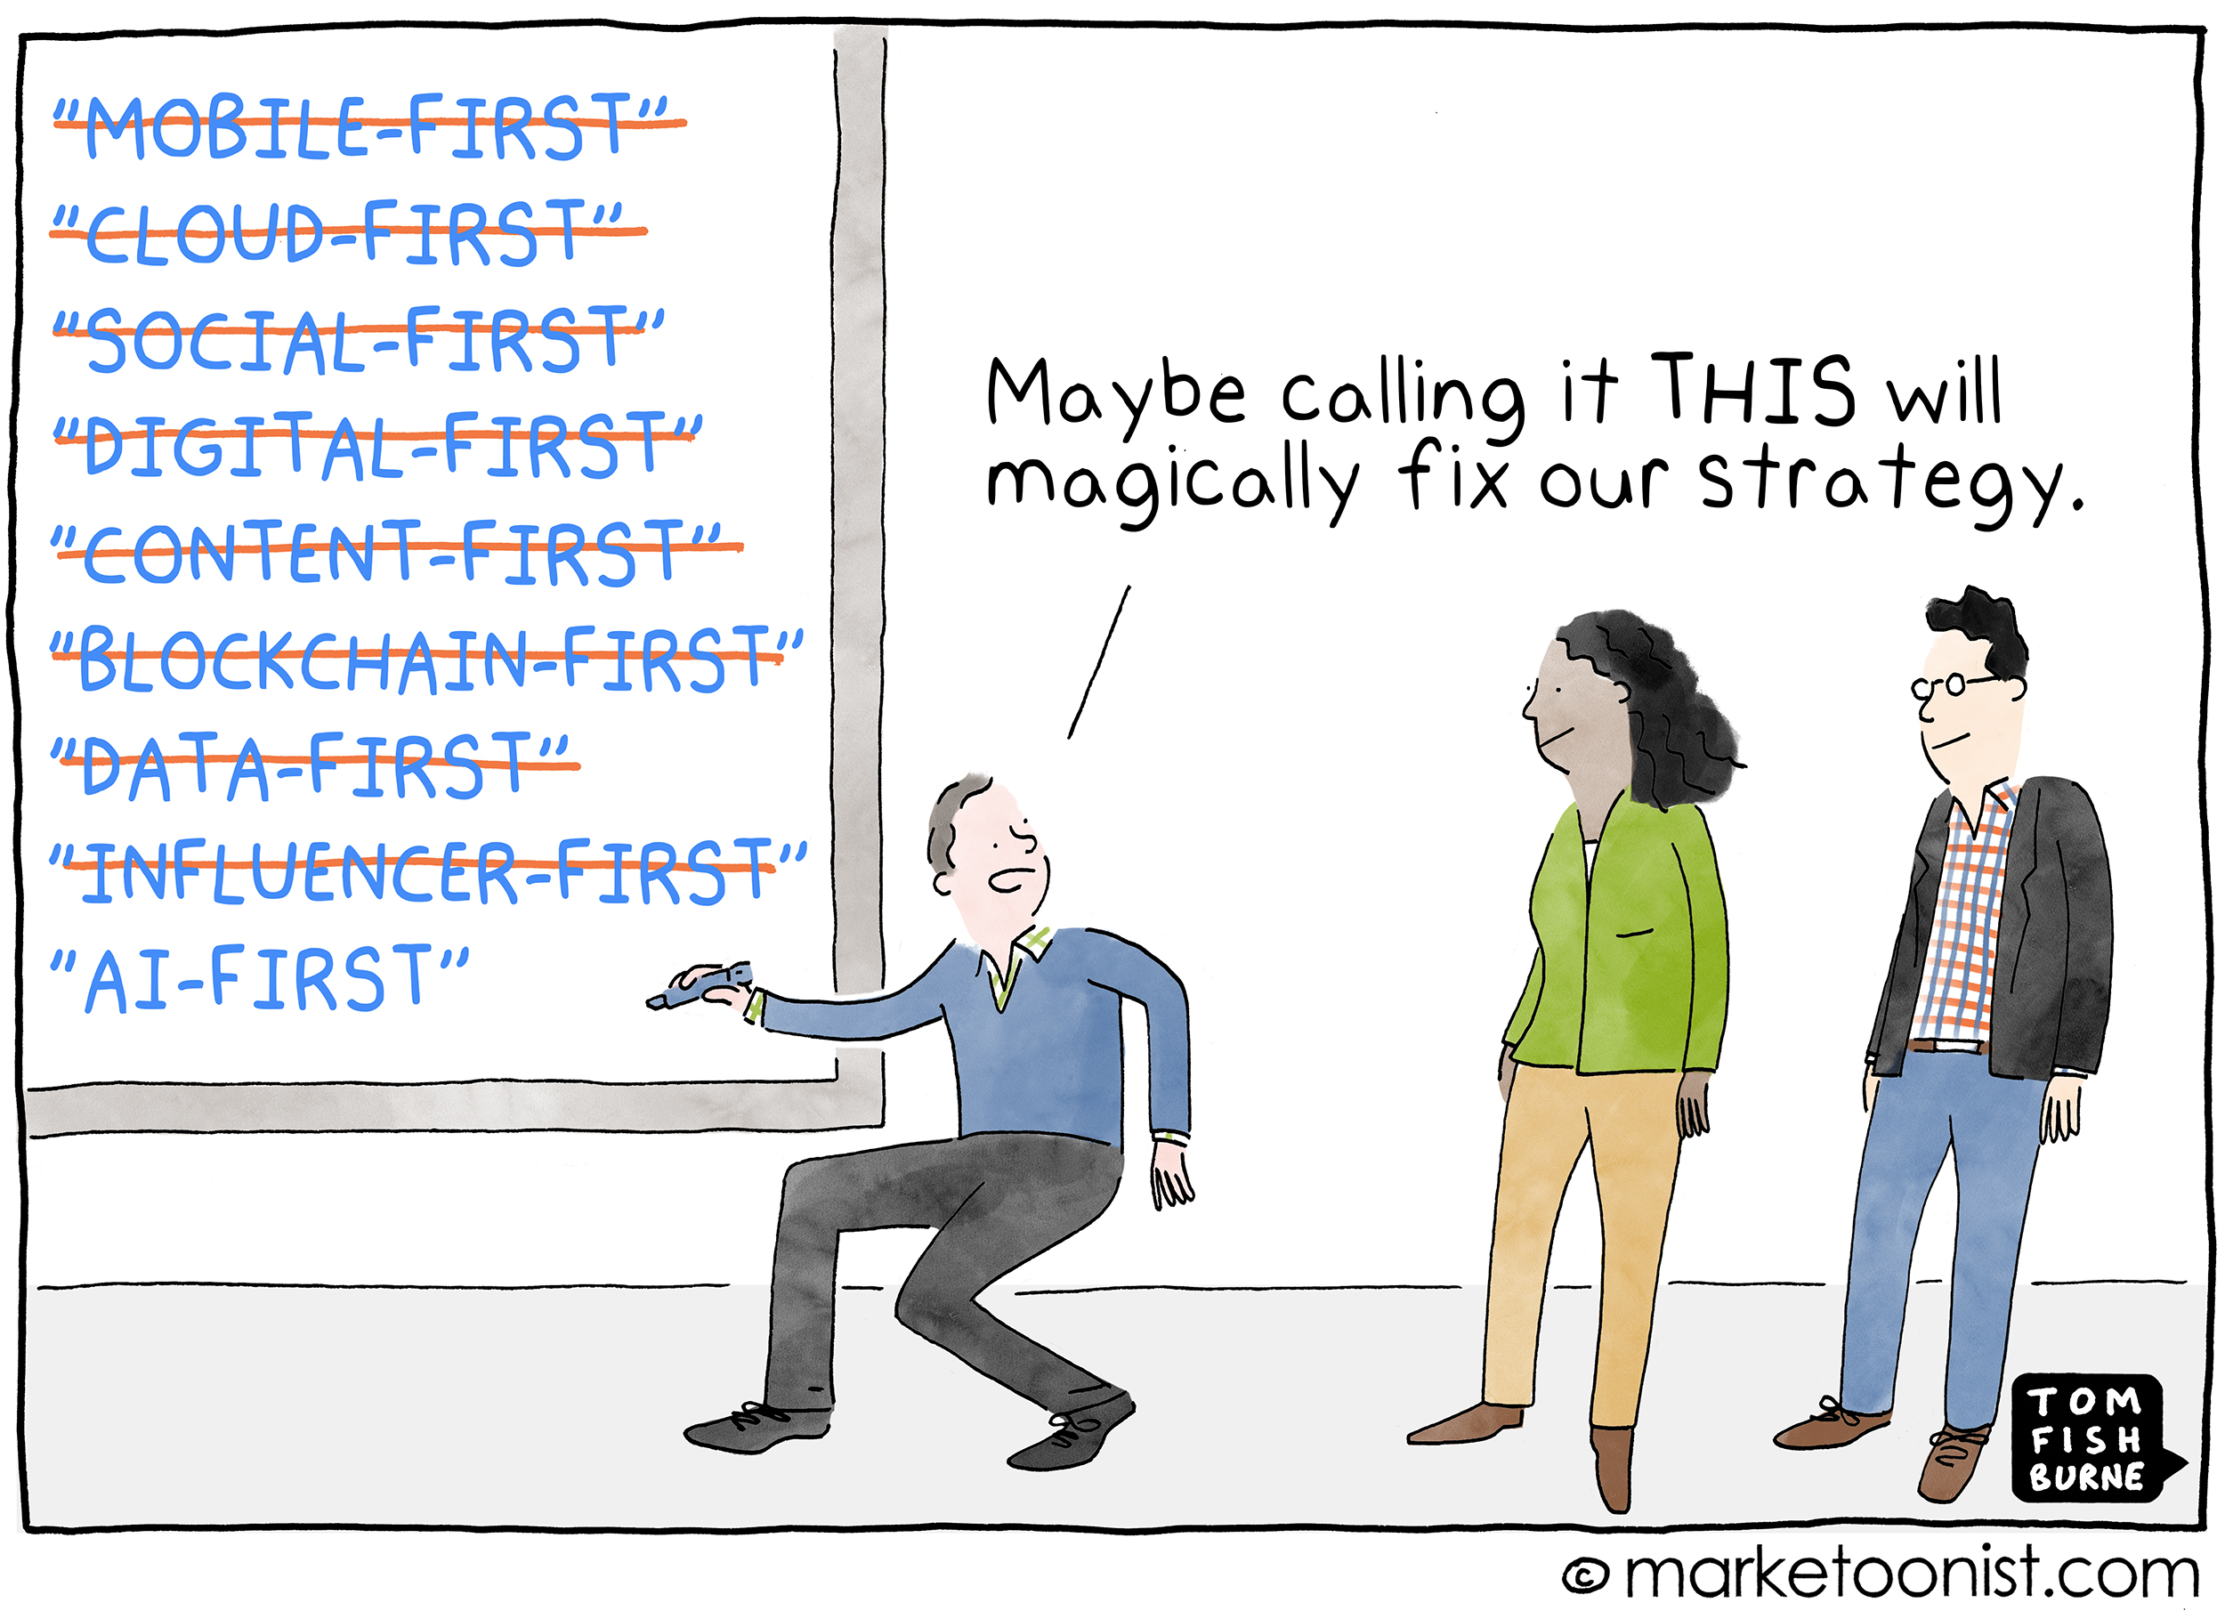
64%
Of companies are applying or will apply AI to customer service
AI For Business Success: 2025-26
Metrigy
Notes:
AI is a game-changer by giving us tools for delivering consistent CX
Let me tell you why we think so.

Slide 7









AI is rapidly solving the harder problems
Understanding intent
Personalization and accuracy at scale
Generating natural language
Empathetic and natural virtual agents
Holding a conversation
Connecting systems
Resolve problems and take actions
Real-time performance analysis
Notes:
Advances in AI are astonishing: Models 10000x larger, trillions in investment
AI is rapidly solving hard problems in contact centers
AI can now:
Understand intent - background noise, accents
Generate natural language less robotic conversation
Hold real conversations - intonation, turn of speech, interruption
Help developers with code for integrations
Provide real time data for monitoring and coaching
This means we can:
Deliver true personalization and accuracy
Create virtual agents that are indistinguishable from humans
Resolve problems not just create tickets

Slide 8
AI is embedded across everything we do
DEVELOPERS & ECOSYSTEM
AI Assistant for Developers | BYO Virtual Agent
Proactive Journeys
AI Agents
Human Agents
Campaign Management
AI Agent linking
Omnichannel, multimodal & multilingual
Scripted & autonomous modes
Execute actions and fulfil intents
Summarization
Responses/Answers
Wellbeing
Performance Management
Webex Connect
Webex AI Agent
Webex Contact Center
Contact Center Enterprise
CUSTOMER EXPERIENCE FOUNDATION
Code Generation | Insights & Analytics
WEBEX PLATFORM
Noise Removal | Prediction | Sentiment | Translation | Summarization
CISCO SECURITY
Notes:
AI embedded across our portfolio:
Webex Connect – our Proactive workload, AI helps with code generation
Webex AI agent - build natural language voice and digital agents that fulfil actions
Webex CC – introduced a host of feature that makes Contact centers more productive
Platform – leverage AI for noise removal and translation.
Let's look at the Webex AI agent in action
[VIDEO]

Slide 9


















Webex Customer Experience
DEVELOPER PLATFORM AND ECOSYSTEM INTEGRATIONS: SOLUTIONSPLUS | OEM | DEVELOPER APPS
User
Customers
Proactive Journeys
AI
Agents
AI-Assisted Human Agents
Business Systems
Customer Experience Foundation
INTEGRATIONS | FLOWS | JOURNEY DATA | KNOWLEDGE | ACTIONS | CHANNELS
Webex Platform
ORDERING | PROVISIONING | ADMINISTRATION | SUPPORT | BILLING | SECURITY | AI
-
Notes:
In this session we will see How Webex Contact Center solves How we orchestrate great experiences for customers and agents
SOLUTION VIEW
3 Pillars: AI Agent, AI assisted Human Agent, Proactive Journey
CORE PRINCIPLE
Meet customers where, when, and how they prefer
Choice of channel, irrespective of time of the day , aligning the exp prefererence, customized and personalized

Slide 10



Before We Begin….
Lab Time to Completion
Beyond Completion
Applied Learning
Pick 1 Mission
Notes:
We have four hours to cover a lot of material and complete many hands-on exercises.
Our goal is not just to finish tasks but to understand how things work and why they matter.
Think about how you'll use these learning in your role, not just how to complete the steps.

Slide 11
DEVELOPERS & ECOSYSTEM
AI Assistant for Developers* | BYO AI*
AI is enhancing everything we do
Proactive Journeys
AI Agents
Human Agents
Campaign Management*
Video Generation*
AI Agent linking*
Omnichannel, multimodal & multilingual
Scripted & autonomous modes
Execute actions and fulfil intents
Summarization
Responses/Answers
Wellbeing
Coaching*
Performance Mgmt.*
CUSTOMER EXPERIENCE FOUNDATION
Code Generation | Insights & Analytics
WEBEX PLATFORM
Noise Removal | Prediction | Sentiment | Translation | Summarization
Notes:
AI implementation across the entire Webex portfolio

Slide 12
Hands-on AI in Action with Webex Contact Center
Dominic Franklin Gonbsalves
Solution Manager - Webex
13 Nov 2025

Slide 13

Meet You
Let's get to know who's in the room today! Your experience shapes our conversation.
Current Customer Profile
Industry Position
Role
Are you using CCE, CCX, or WxCC solutions currently?
Non –Cisco Contact Center or Partners?
Architects, implementation engineers, and operations ?
Notes:
Whats your Take and experience

Slide 14
Agenda
01
CX and Webex Contact Center Intro
02
Contact Flow and AI layout
03
Lab Overview
04
Topic Analytics
05
Autonomous AI Agent
06
AI Assistant
07
Power of Proactive + AI Agent
08
Scripted AI Agent (Bonus)
09
Integrate Digital Channels (Bonus)
10
Resources & Conclusion

Slide 15
Download PDFs of Slides:
To follow along: without hidden slides
For Extras: with hidden slides

Slide 16
Lab | Duration
Intro, Users and Interface, Lab Overview | 5 min
Autonomous AI Agent | 60 Min
Scripted AI Agent | 15 min
Wrap-up Q&A | 10 min

Slide 17
Lab | Duration
Intro, Users and Interface, Lab Overview | 30 min | KRISHNA
Topic Analytics | 15 Min | KRISHNA
Autonomous AI Agent | 60 Min | KRISHNA + BARRY
AI Assistant | 30 min | BARRY
AI Suggested Response | 30 min | MYKOLA
Power of Proactive Engagement | 30 min | KRISHNA
Scripted AI Agent - Bonus Integrated Digital Channels - Bonus | 15 min | MYKOLA
Wrap-up Q&A | 15 min

Slide 18
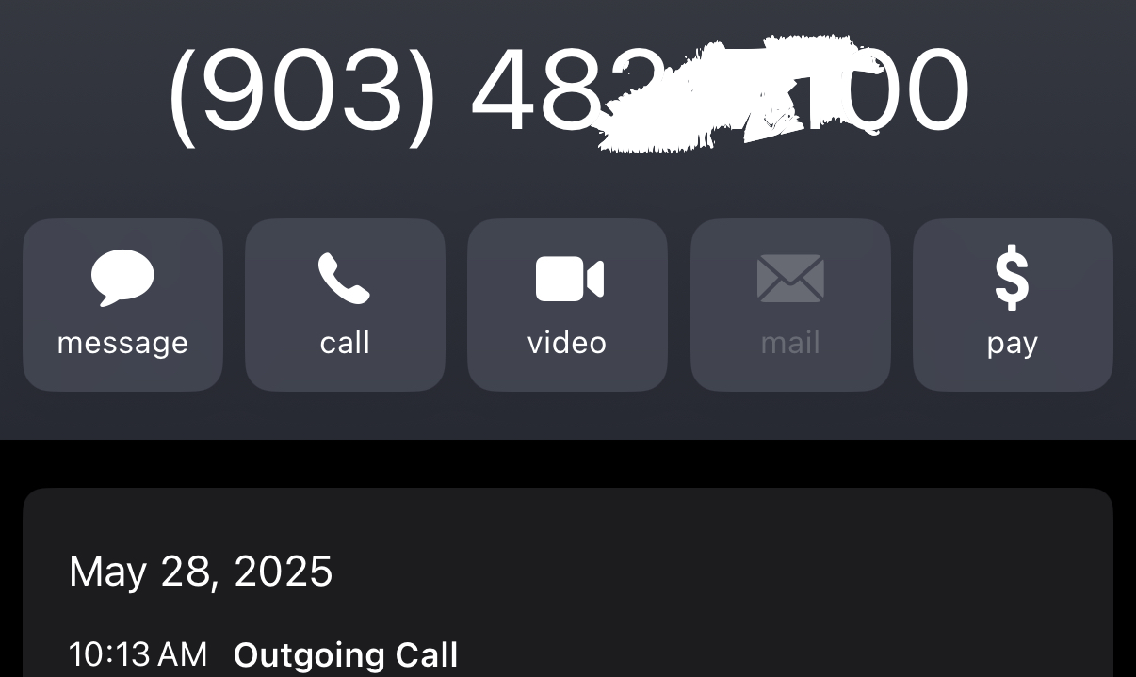





Customer Experiences Flow
x
Customer
IVR
Answers
Agent
Answers
Agent
Ends
Post Call
Survey
Agent Exp
Self-service Exp
Routing
Queue Exp
Welcome → Options → AI Agent → Routing → Queue
Customer
Experience
CX Orchestration Experience
Notes:
I hope you all had a great time last night.
WORKING FROM HOME… POWER GOES OUT
No SMS or app alert
Visit website → find contact center number → call
Agent has no context
I give name, address, explain the issue
Response: “Yes, outage. Power will be back in 2 hours.”
THIS IS A TYPICAL EXPERIENCE — something many of us have faced.
NOW THINK — WHAT WENT WRONG HERE?
Let me know if you’d like a version adapted for slides or a visual aid.

Slide 19


Problem with that Experience?
$1 per Min
2 min x100 calls = $200
Reactive Support
Saving=$100
Human Agents
1 min x100 calls = $100
Know your Customer, Contextual Agent Interactions
Saving=$170
Intelligent Automation
2 min (15 cents) x100 calls = $30
AI
Agents
Business Applications Integrations, AI agent
Saving=$195
5 cents x100 SMS = $5
Proactive Engagement
Proactive Journeys
A proactive SMS costs just pennies while improving
customer satisfaction.
Notes:
1. WHAT WENT WRONG?
I had to call in, agent had no context
Imagine this happening 100 times
2. WHAT COULD BE BETTER?
Know your customer, show context
Cut call time by 50% → save $100 per 100 calls
3. DO WE NEED A HUMAN AGENT?
AI agent could confirm outage
2 min @ 15¢/min = 30¢ per call → $30 for 100 calls
4. SHOULD THEY EVEN CALL?
NO — MAKE IT PROACTIVE
Detect outage → send alerts with status + ETA
ESTIMATES — BUT CLOSE TO REALITY
Let me know if you need this styled for slides or a visual cue deck.

Slide 20
Assisting Agents at Every Step
Human Agents
Summarization
Responses/Answers
Wellbeing
Coaching*
Performance Mgmt.*
Agent Interaction
Agent/Supervisor Interaction
Metered Call Duration
Pre-interaction
Greeting
Conversation Duration
Bye
Post call work
Post call analytics
AI Agents
Omnichannel, multimodal & multilingual
Scripted & autonomous modes
Execute actions and fulfil intents
Wrap up summaries
Auto CSAT score (voice)
AI Agent context Transfer summary
Real time transcription
Drop call summaries
Suggested responses
Topic analytics
Agent wellbeing breaks
Auto CSAT Coaching highlights
Notes:
Topic Analytics surfaces key reasons customers are calling into the contact center.
It aggregates call transcript data and models trends succinctly for business analysts, so they can proactively adapt to meet the needs of customers.
This capability is self-learning, constantly getting smarter from customer interactions.

Slide 21



Slide Visual cues
Use Case
Early Access
For reference
Notes:
YOU'LL SEE SOME VISUAL CUES THROUGHOUT THE SESSION.
Anything marked as "reference" is supplementary to that section.
We won’t go deep into those now, but they’re there for your reference.
You can explore them later—a lot more is included in the appendix for your awareness
AS WE TALK ABOUT FEATURES AND CAPABILITIES:
Some features are recently released and Generally available , they are marked as “new”.
Others are in early access and not yet generally available.
Typically, it takes 2 to 4 weeks for a feature to move from early access to GA.
LOOK OUT FOR THOSE MARKINGS—THEY HELP YOU KNOW WHAT’S READY NOW AND WHAT’S COMING NEXT.

Slide 22
Users and Interfaces
© 2024 Cisco and/or its affiliates. All rights reserved. Cisco Public

Slide 23


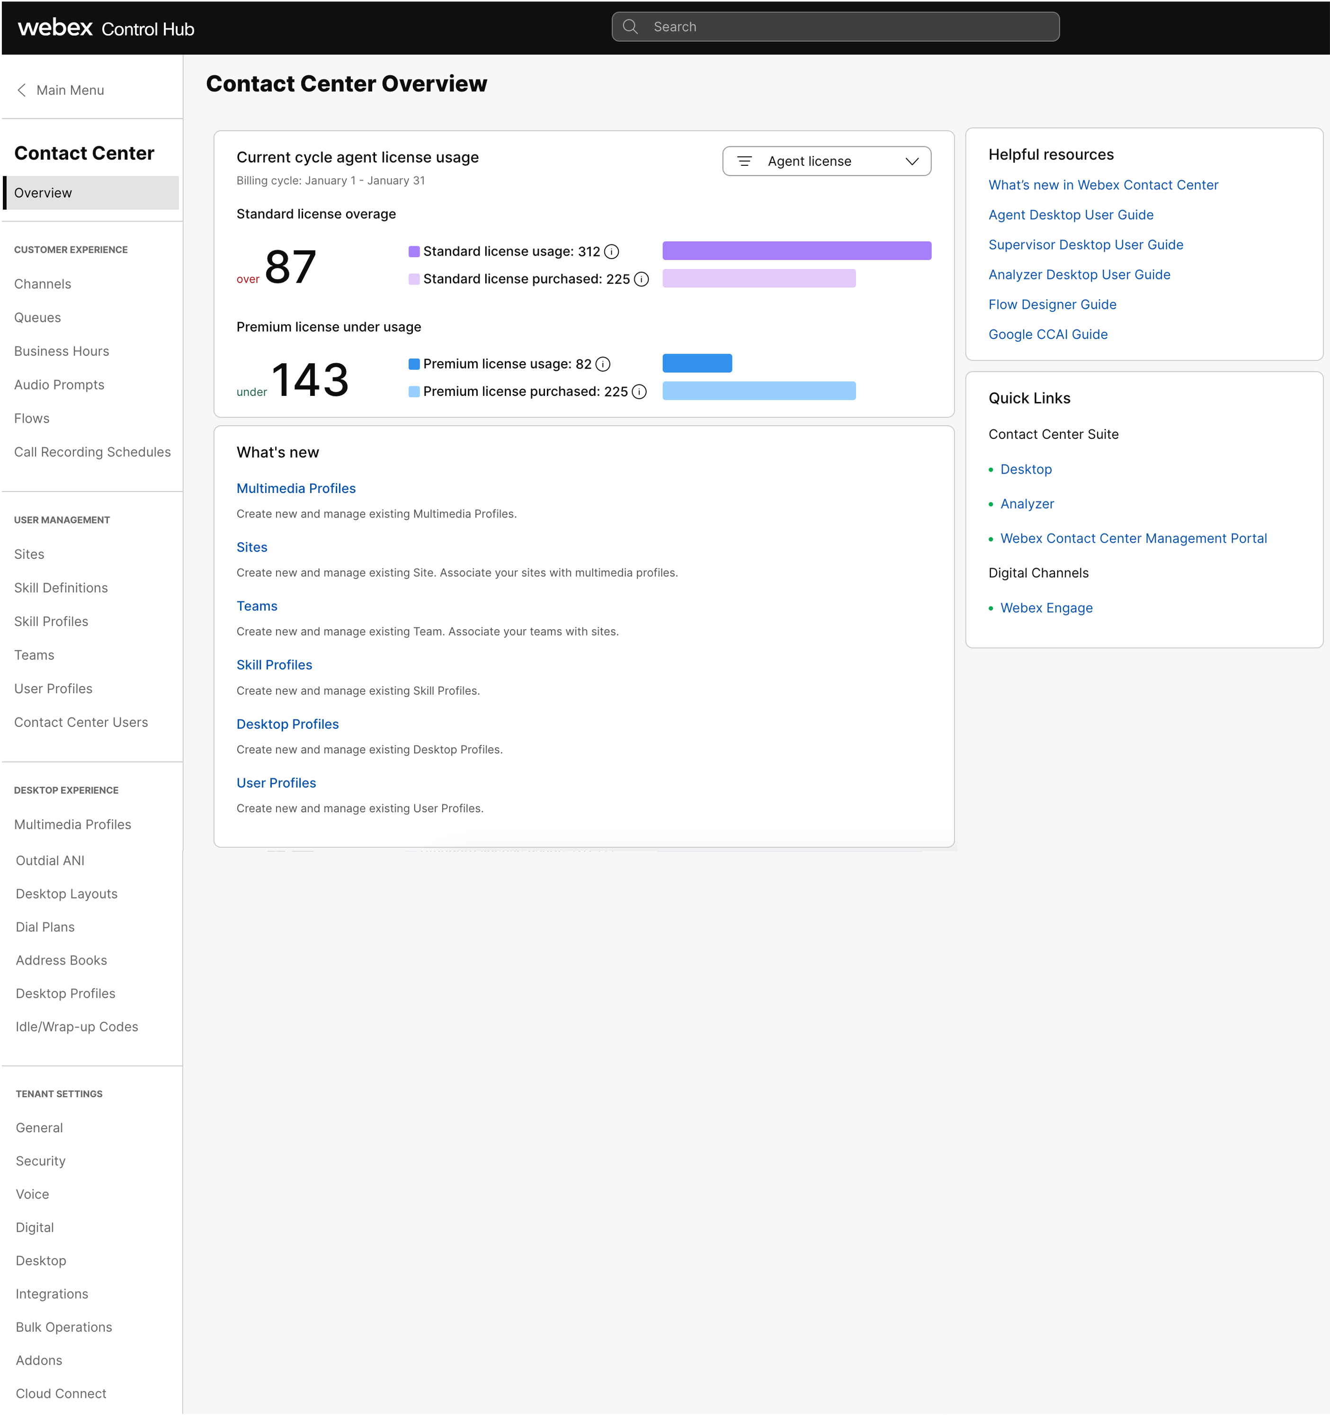
Administrator
Centralized Administration
Visibility
User management.
Notes:
Now lets take a look into Webex CC,
What you here is the landing page for the administrator.
I am sure many of you recognize it, Webex Control-hub.
It is the administration cockpit for everything Webex , Calling , meeting , Contact center.
Centralized Administration, Visibility and user management.
simplifys administration—driving efficiency

Slide 24
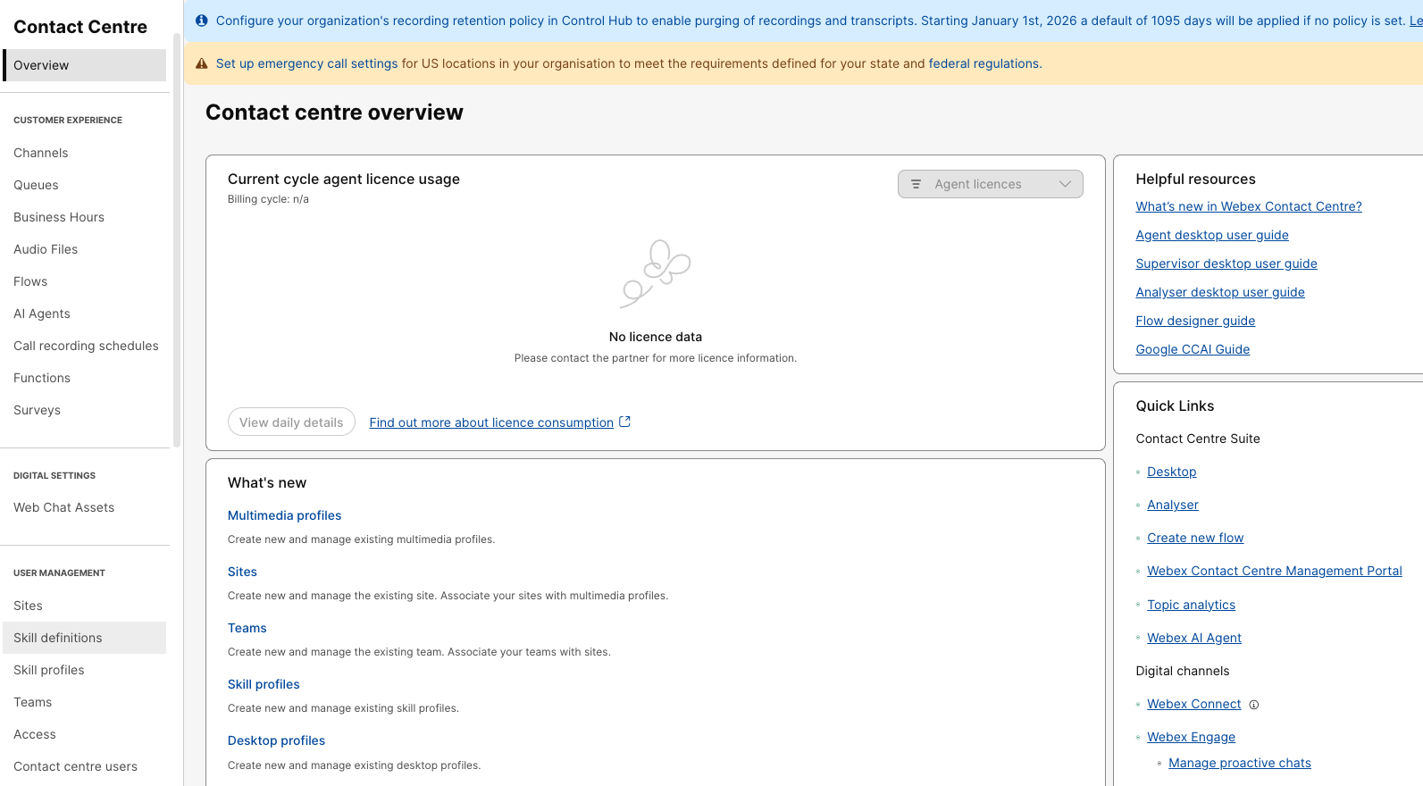
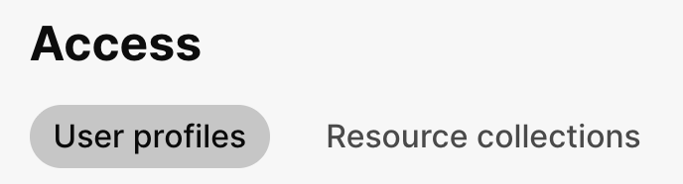
Control Hub : Contact Center Overview
Resources organized into simple, easy-to-navigate sections
Customer Experience
CX Config / Flow
AI Agent
User Management
User Config
Access*
Contact Center Users
TRAINING : Roles-based access control for Webex Contact Center.
SEP 28 4:00 PM – 5:30 PM PT
* Early Access
Notes:
explore the Contact Center options, - range of resources, organized into simple, easy-to-navigate sections
Starting with CX - Flow Orchestration and AI Agent
User configuration : including set users role: Agent , supervisor and Adimintration as well as
Jonathan / Dinesh – Attened ? Recording
We have introduced a Very powerful Roles-based access control module for Webex Contact Center. Called Access (
keeping in mind our customers security and compliance requirements, to delegate granular access controls to Adminstartors, Supervisors, Agents

Slide 25
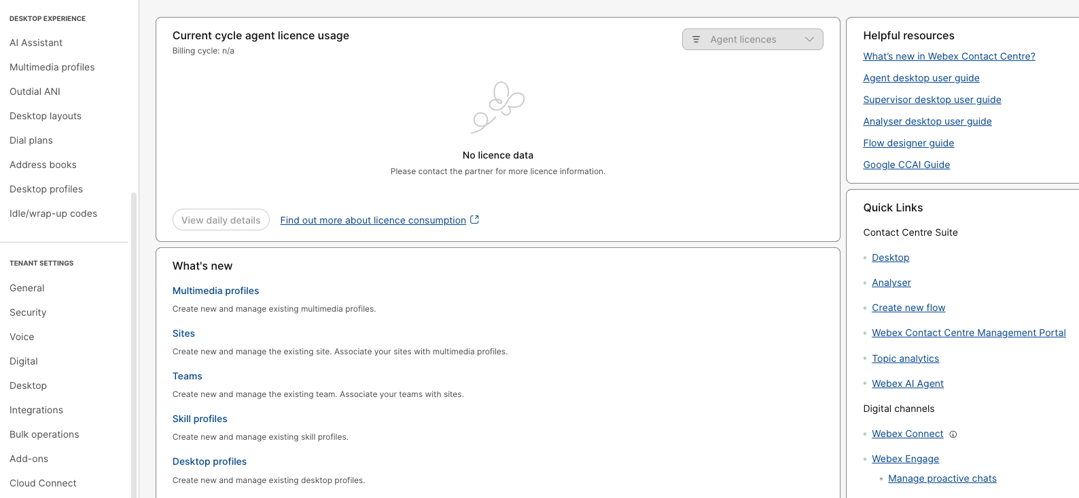
Documentation
Desktop Experience
AI Assistant
Desktop Layout
Desktop Profile
Quick Links
Tenant Settings
Agent / Supervisor Desktop
Voice
Analyzer (Reporting)
Digital
AI Topic Analytics
Desktop
Digital Channels Flow
Notes:
If you scroll down, you’ll find the Desktop Experince options.
define look and feel for Agent and Supervisor desktop based on their workload business needs
Including: Desktp layout and Desktop profile as well as access to the AI Assistant.
Tenant Settings: Voice, Digital and Desktop Tenant level settings.
Like Inactivity timeout, RONA timer etc. Integrations and many more

Slide 26
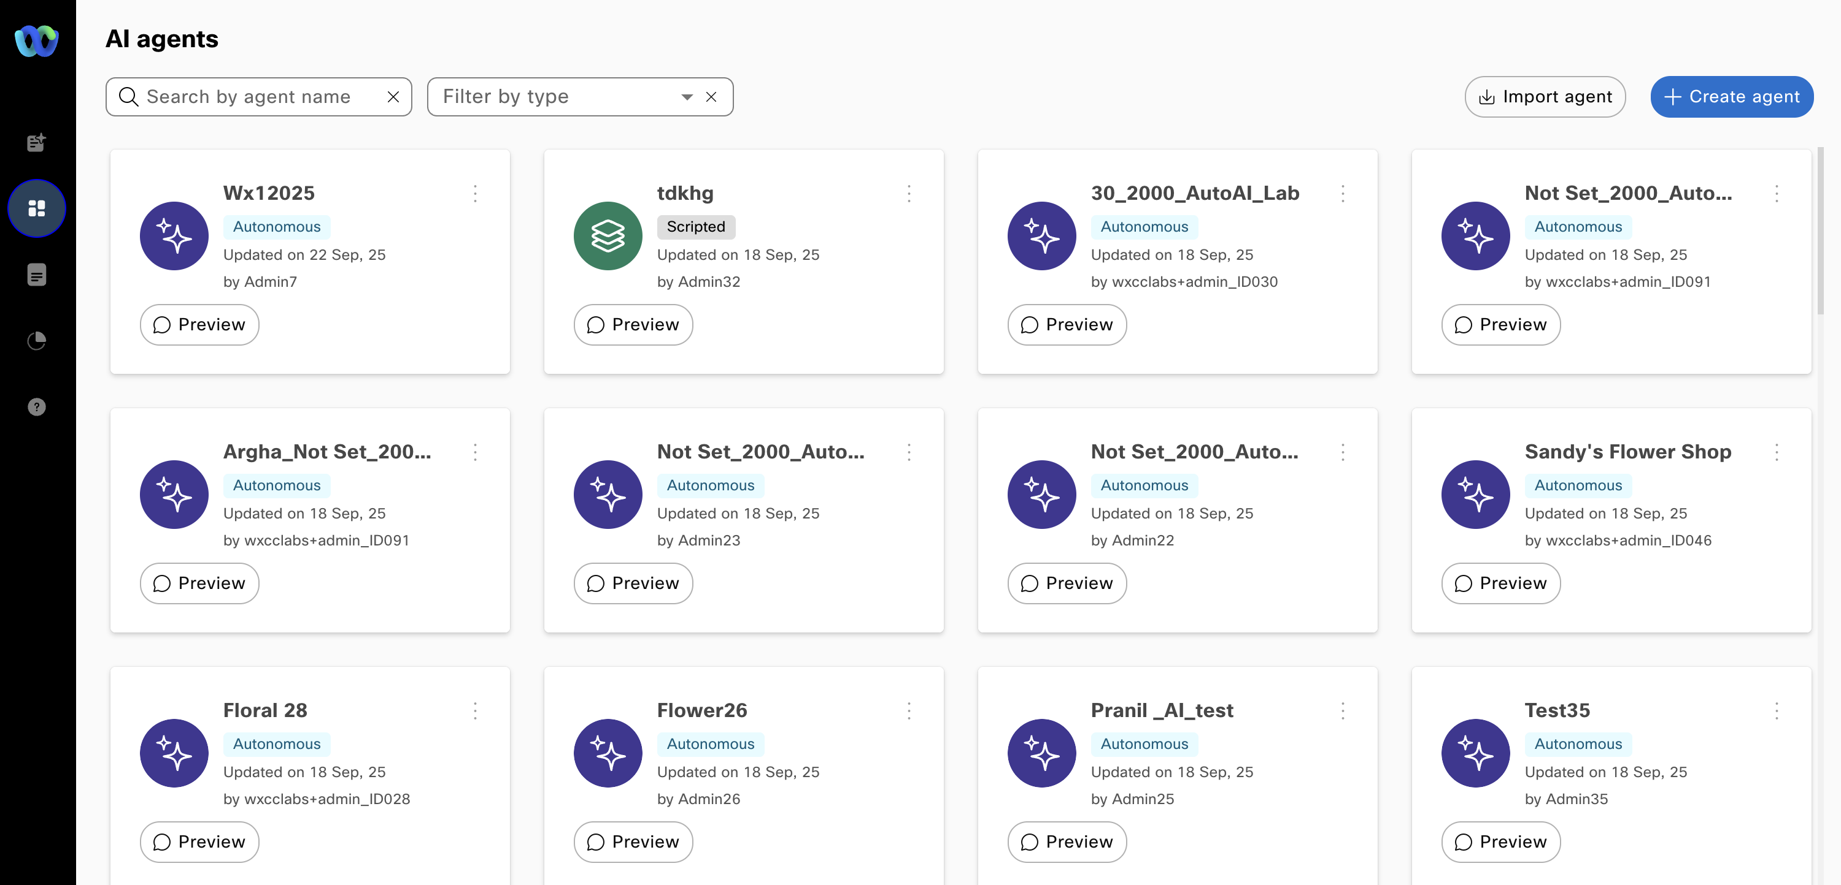
AI Studio
AI agents
Cisco AI Assistant skills
Human Agents
AI
Studio
Summarization
Responses/Answers
Wellbeing
Coaching*
Performance Mgmt.*
Omnichannel, multimodal & multilingual
Scripted & autonomous modes
Execute actions and fulfil intents

Slide 27
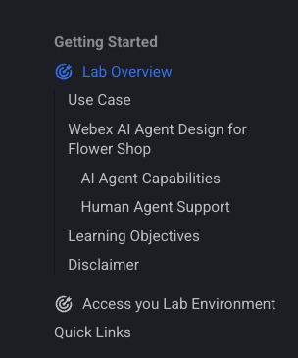
Lab Instructions
Each Lab include multiple Missions to cover that topic
To complete each Mission, you must complete list of Tasks
Some Mission and Tasks are Read-Only and Pre-configured.
Slides and Demo: Concepts and Read only sections and other labs.
Each Lab has supporting GIF Videos and screenshot, leverage those to follow the instructions.
Need Help!! Just Raise your hand or post in the space Hands-on AI in Action with Webex Contact Center: In Room Lab Support (all Lab users are added)
When making the calls, Use headphones as needed
Slides → Demo → Q&A → Hands-On Lab

Slide 28
Lab Access
https://webexcc-sa.github.io/LTRCCT-2000/main/overview/
Administrator- Make Agent enable
Supervisor – Webex Phone – No
Agent - WebRTC

Slide 29
Let's Go!!

Slide 30
Thank you

Slide 31
Cisco

Slide 32
Template usage guidance

Slide 33
Everyone is responsible
Cisco data classifications
Classification | Examples
Cisco Public Data is non-sensitive data that is copyright/ trademark protected. | Including, but not limited to: Products and services data sheets, specifications benefits Financial information such as quarterly earnings reports
Cisco Confidential This is our most common data classification. Data is private or proprietary information that is protected from disclosure to the public domain. | Including, but not limited to: Process/business/technology information Sales/commerce information like contract, invoice, etc.
Cisco Highly Confidential Data is highly sensitive information that is critical to Cisco’s ongoing operations. | Including, but not limited to: Business/marketing strategy and product/marketing/offering forecasts, discounts Customer-specific online information, such as IP/Mac address
Cisco Restricted Data is the most sensitive data, having the highest degree of restricted access and security protection. | Including, but not limited to: Personally identifiable information (social security number, driver’s license, passport, fingerprints) Data is owned by a user/group with very restricted privileges

Slide 34
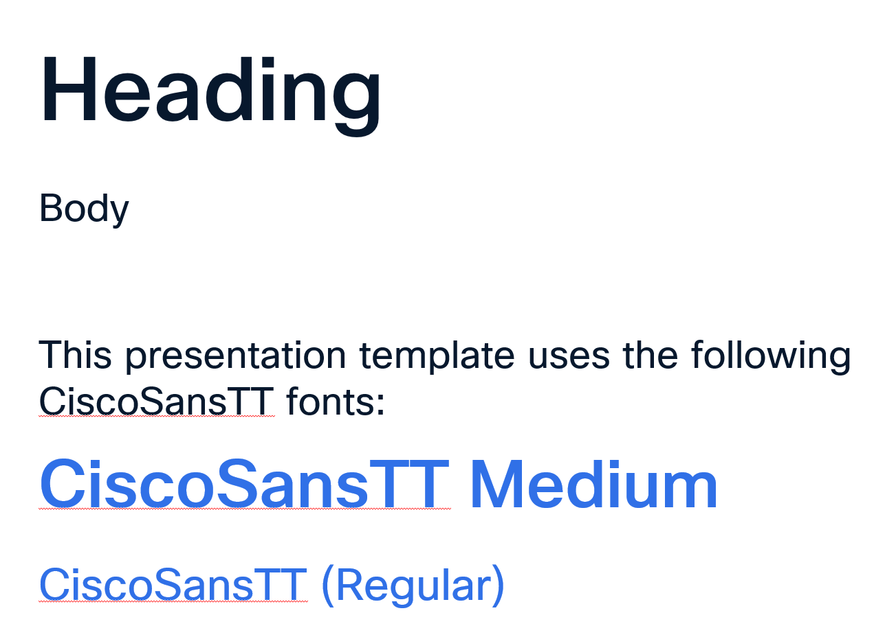
Our typeface
Heading
Body
This presentation template uses the following CiscoSansTT fonts:
CiscoSansTT Medium
CiscoSansTT (Regular)
If the text in this column does not match the styles of the text in the image on the right, please take a moment to install the fonts. Otherwise, your presentation will not display correctly.
Please download the fonts from Cisco Brand Exchange.
This image shows typography as it should appear when the correct CiscoSansTT fonts are installed.

Slide 35
Ensuring our brand is accessible for all
Cisco's purpose is to power an inclusive future for all. We deliver on our purpose by fostering an inclusive and diverse culture in which employees can be their whole selves while building new skills, exploring areas of interest, and becoming catalysts for social change.
To this end, Cisco Brand and, Cisco Creative Studio, are partnering with some of the leading minds in design and accessibility to create a set of accessibility standards for all of Cisco's Brand assets and tools. We are in the beginning stages of this development and ask that you come along on this journey with us.
Be on the lookout over the coming quarters as we release improved guides, tools and templates that comply with our recommended standards for both online and offline assets.

Slide 36
CiscoSansTT font family
CiscoSansTT is our typeface. But our typography is more than words on a page—use it to bring the big idea to life. We have a weight for every occasion. These are the ones we use most often. Colored type should be reserved for special callouts in H1-H5 sizes. Subtitles, body copy, and label sizes should generally be the default White or Midnight blue, dependent on the template.
Please refrain from using PowerPoint via Microsoft 365 (desktop is OK). Microsoft 365 currently has compatibility issues with CiscoSansTT custom fonts. In the meantime, when collaborating on files, we suggest that you first open the PowerPoint file on your desktop before making edits.
Section title
TT Regular 12 pt
H1
TT Medium 40 pt
H2
TT Medium 24 pt and above
H3
TT Bold 20 pt and under
Subtitle 1
TT Regular 16 pt
H4
TT Bold 16 pt and under
Body copy
TT Regular 16 pt is the default
Hyperlink
TT Regular, underlined
Labels 1
TT Regular 10-16 pt
Labels 2
Bold < 10 pt

Slide 37



Colors and elements
New brand colors
Our new palette consists of a base palette used as backgrounds and primary text colors on communications, and a secondary palette of vibrant colors to be leveraged as accents on the base colors. Most communications will leverage our base palette, primarily using White in the dark template and Midnight Blue in the light template. The base palette is the foundation to leverage our secondary palette, either as tints or solids. The secondary palette consists of four colors, reserved for intentional use within layouts to create a bit of vibrancy and energy. Various shades of grey may be used in supporting roles.
Base palette
Secondary palette
Supporting greys
White
#FFFFFF
RGB 255, 255, 255
AAA
AAA
AA
Midnight Blue
#07182D
RGB 7, 24, 45
AAA
AA
AAA
AAA
AAA
Medium Blue (Webex)
#3070E7
RGB 48, 112, 231
AA
Light Grey
#D6D6D6
RGB 214, 214, 214
AAA
Cisco Blue
#16BDEB
RGB 22, 189, 235
AAA
Medium Grey
#6B6B6B
RGB 107, 107, 107
AA
Magenta
#FF007F
RGB 255, 0, 127
AA
Feedback colors (Use sparingly)
Green
#45991F
RGB 69, 153, 31
AA
Orange
#FF9000
RGB 255, 144, 0
AAA
Red
#EB4651
RGB 235, 70, 81
AA
AAA and AA represent WCAG accessible type ratings for body size text. WebAIM contrast checker >
Elements
Depending on the template, either White or Midnight Blue lines are recommended for miscellaneous lines, diagram connectors, leaders, and basic drawings. Use gradients sparingly. Avoid gradient and solid filled shapes.
1.25 pt lines
Standard line treatments
Rounded corners
Use rounded corners on most container style boxes and picture frames except for titles and segues.
Icon samples

Slide 38
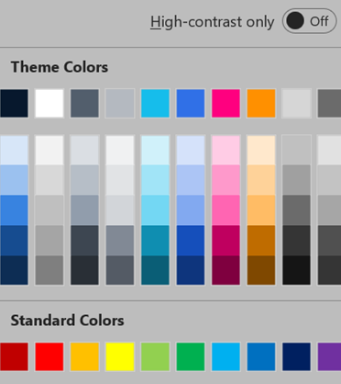
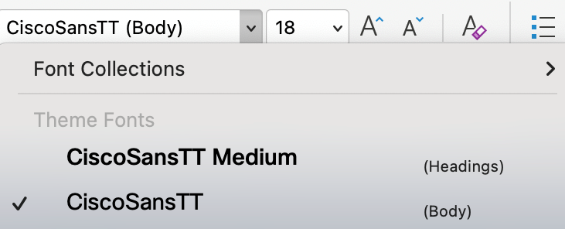

Only use the themes provided
Always use the template themes. It ensures consistency and reduces editing time when you share content between presentations.
Theme colors
Theme fonts
PowerPoint provides two theme fonts – one for headings and one for body. They are found at the top of the font menu. Do not select fonts from the “All Fonts” section of the list.
Our brand colors are included in the theme color section. Use only these colors and associated tints/shadows.
Do not use PowerPoint’s Standard Colors or create custom colors.

